Slide 1

Setting up ChattyISS
Lee Kah Wai

Slide 2
Agenda
Brief Overview
Migration procedure
Verify crontask working
- Ensure that nightly update could generate
updated contents.
Remove ChattyISS OpenAPI keys from code

Slide 3
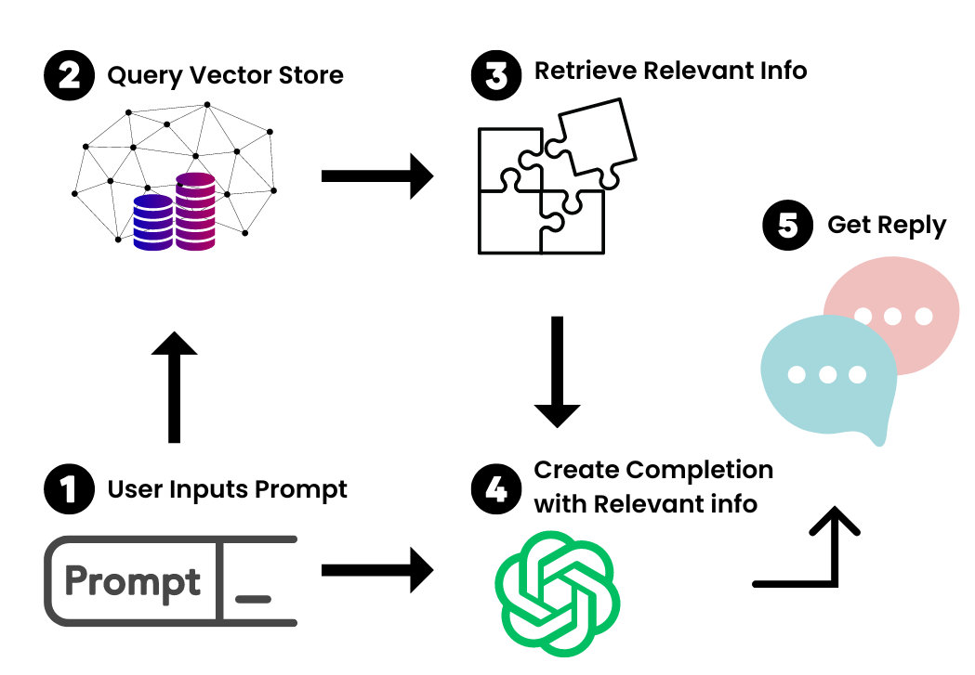
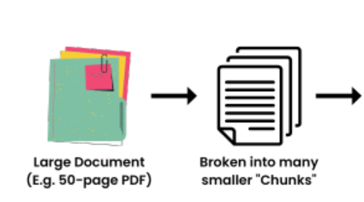
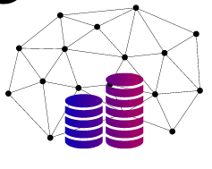


Overview
LangChain
Insert additional data (external) into existing large language model
How it works
vectorstore

Slide 4
Setting up
System Requirements:
Windows PC with WSL support with Ubuntu OR
Debian based OS (e.g. Ubuntu)
Check out code from Github
sink257/IRS-PM-2023-03-06-ISY5001-GRP-Two.AI-ChattyISS (github.com)

Slide 5
Setting up
Update OpenAI key into the following files:
chatbot.py
chatbot_gpt4.py
imagebot.py
ingestion.py
understandingimages_llama.py
They could be found in the following path “SystemCode\backend\endpoint\NUS_ISS_chatbot”
The trainer shall help to insert the OpenAI key during the training.
API keys - OpenAI API
Terminate Azure service. Ensure that no one can use Telegram app on ChattyISS

Slide 6
Setting up
The code is now ready, but we still need to download the necessary python and linux plugins at the backend.
While still in SystemCode\backend\Endpoint,
Execute the following commands:
sudo apt-get --assume-yes install tesseract-ocr
sudo apt-get --assume-yes install libtesseract.dev
sudo apt-get --assume-yes install poppler-utils
pip install -r requirements.txt
Now you can run the server:
python3 main2.py Alternatively create a shell script to run the command with “nohup” (running on background)
This concludes the backend service installation

Slide 7
Setting up
Update on current status
vectorstore
Haven’t update
completed
Installing the frontend services
Creating the telegram application

Slide 8
Setting up
Navigate to SystemCode\frontend\telegram
Install the following requirements:
pip install -r requirements.txt
Run the shell script runserver.sh
Verify at this juncture that telegram services had been resumed.

Slide 9
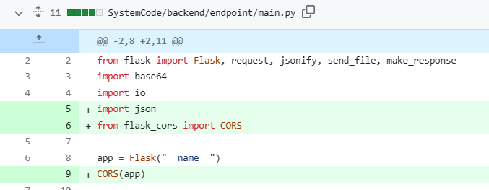
Setting up
Optional (Setting up the website)
No installation is required, just run the script “runserver.sh”
If telegram works but not the website. It could be due to CORS issue
In main2.py remove or add the CORS segment accordingly

Slide 10
Crontask
First, the pdf folders are supposed to reside in the following folder.
backend\endpoint\pdf
All key PDF data with tabular information to be stored in:
backend\endpoint\pdf\Timetable
Navigate to backend\endpoint\NUS_ISS_chatbot
Edit ingestion.py
Uncomment and comment the model to be generated. For simplicity, we suggest the GPT3.5 model

Slide 11
CronTask
Backup and remove the following folders to verify that the files are regenerated.
Create a backup folder in backend\endpoint
Move the following folders into the backup folder
Images
NUS_ISS_chatbot\gpt3.5_model
NUS_ISS_chatbot\gpt3.5_small_model
NUS_ISS_chatbot\gpt4_model

Slide 12
CronTask
In backend\endpoint folder, execute crontask.sh
This will take a while.
~ 20mins for Tesseract generation of images
~ 6mins for OpenAI embeddings
Go for toilet break
Verify that the following tables are regenerated.
Images
NUS_ISS_chatbot\gpt3.5_model
NUS_ISS_chatbot\gpt3.5_small_model
NUS_ISS_chatbot\gpt4_model
Test out OpenAI with the updated model. Verify that it still works.

Slide 13
Removing key from OpenAI
Trainer shall remove the key within OpenAI platform. It shall not be able to be used after this.

